Slide 1

INVESTMENT HELPER CHATBOT (TEAM-12)

Slide 2
INTRODUCTION
A Chatbot is an intelligent conversational agent that is designed using certain software program and works by establishing a conversation between a bot and user or in some cases between the bots
A simple daily life example of a chatbot can be of an Apple’s Siri, Amazon’s Alexa or the IBM’s Watson
The chatbot can be either a commercial one which is very industry specific or can be an opensource one which can be used as a base model to implement it in any industry scenario
In this project, we are trying to build the chatbot that would be your personal investment guide
The goal is to ease the investment system

Slide 3
DATA SOURCES
In order to create a csv file to conduct data analysis we have mined the data from the following websites:
moneycontrol.com : To create a dataset that has the opening price of each of the top 200 companies for a period of one year we have used moneycontrol.com to scrape the data from it
moneybhai.com: To create a dataset consisting the user’s credentials, companies of interest for investing in stocks we have used moneybhai.com

Slide 4

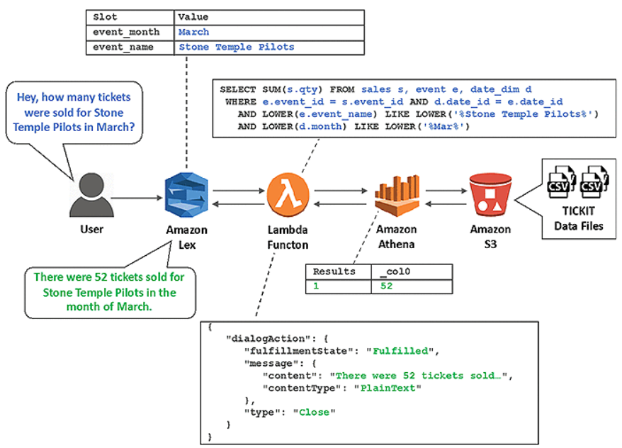



A SIMPLE DATA FLOW PIPELINE

Slide 5
TOOLS USED
In order to built an Investment helper chatbot we have used the following tools that are available through Amazon Web Services :
Amazon Lex: To built the chatbot
Amazon S3: To store the dataset in the S3 cloud bucket and use it further through integration with other technologies
Amazon Athena: For obtaining data in tabular form and running SQL query inside it and obtain solutions for the queries
Lambda Function (Amazon): For creating interaction between lex and athena we have used Amazon’s lambda function

Slide 6
AMAZON LEX
Amazon Lex is an AWS service that is offered by Amazon Web Services to create chatbots for building conversational interfaces using both voice and text.It works on the same technology that powers the functionality of Amazon’s Alexa and uses Natural Language Processing techniques such as NLU (Natural Language Units) and Automatic Speech Recognitions for simulating human like conversations with the users.
Amazon Lex provides pre-built integration with AWS lambda and can be easily integrated among other amazon’s services such as Amazon’s Cognito, Amazon’s DynamoDB etc.
Amazon Lex manages the dialogue and dynamically adjusts the responses in the conversation. Through the SLU(Speech Language Understanding) the amazon lex takes the natural language speech and text input and fulfills the user’s intent by properly executing the required business task.
In our project we are building the chatbot using text based inputs from the user

Slide 7
AMAZON LEX’S WORKING
The amazon lex chatbot follows the following steps in order to execute the commands provided through the intent provided by the user:
The first step involves creating the bot and configuring it with one or more intent that the organizations application has to support
In the next step the bot configuration has to be done in such a way so that it understands the user’s goals (intents) is able to engage in conversation with the user to extract information that would help the bot in fulfilling the user’s intent.
In order to test the bot there is a testing window provided by amazon lex console, the testing of the bot should be conducted once the intents are explicitly stated in the above mentioned step
The next step involves publishing the version of bot and creating an alias
The last step involves deploying the bot in any mobile application or messaging platform such as facebook messenger

Slide 8
AMAZON LEX’S ARCHITECTURE
Bot: A bot performs automated tasks such as ordering a pizza, booking flight tickets, booking a hotel room etc. The amazon lex bot is powered with Automatic Speech Recognition (ASR) and Natural Language Understanding (NLU) capabilities, the same technologies that are functional in Alexa. Amazon Lex understands the user input provided through speech or text and can converse in natural language.
Lambda Function: Lambda function are added as code hooks so that they can perform the user data validation and fulfilment tasks.
Intent: An intent essentially represents a task that the user wants the bot to perform. A bot can be created that supports multiple intents such as a bot which can order both drinks and pizza. For each of the following intents the following required information has to be provided:
Slot: Slot are nothing but the parameters of the intents. An intent can have from zero or more slots or parameters. At runtime amazon lex asks the user for specific slot values. The user has to provide values for all the required slots before the Amazon Lex can fulfill the intent

Slide 9
LAMBDA FUNCTION
AWS Lambda is an event-driven, serverless computing platform provided by Amazon as a part of the Amazon Web Services
After receiving an input from Lex, the Amazon Lambda function uses data to construct a SQL query and execute it against Amazon Athena database.
The amazon Lex bot can be configured to invoke the lambda function as the code hook. This code hook can be used for multiple purposes such as:
For customizing the user’s interaction, eg: If a particular user asks about available pizzas toppings, a prior knowledge of user’s preferences could be used to display the subset of toppings
To validate the user’s input, eg: If the input is picking up flowers at a particular time then the time can be validated and appropriate response can be sent.
For fulfilling the user’s intent: After the user provides all the information for his/her order lex can invoke lambda function to place the order with local pizzeria.

Slide 10
AMAZON ATHENA
Amazon Athena is easy to interact query service of amazon that can be used to analyze the data in amazon S3 using SQL query.Athena is serverless hence there is no need to any infrastructure to be managed.
Athena can be put to use once the dataset is loaded in the amazon S3 bucket and the schema for the data is defined the SQl query can on run on the data after integrating it with amazon’s S3
The main advantage of athena is there is no need to prepare the data through ETL(Extract Transform Load) jobs to prepare the data for data analysis. This makes large scale analysis of data very easy.
Amazon athena helps in analyzing the structured, unstructured and the semi structured data that is available in the amazon S3 bucket. The examples of the data that can be used to query in the athena are CSV,JSON, or columnar data formats such as Apache Parquet and Apache ORC.

Slide 11
AMAZON S3
Amazon S3 refers to the Simple Storage Service offered by the amazon and is an object storage service.
Large amounts of data can be stored using amazon s3 for any use case starting from creating data lakes to analytics.
The S3 is designed to be 99.99% efficient in case of site level failures and errors.Amazon S3 allows in managing data at all levels i.e account, bucket, object levels, making it very easy to replicate, tier, query or monitor and configure and access to entire bucket, single object or an account.
The best feature of amazon S3 is easy integration with lambda function for performing more complex task such as data preprocessing.

Slide 12
ACCOMPLISHMENTS
Creation of a STACK on the CLOUD FORMATION using integration of github, AWS S3 json template.
Integration of AWS Athena with the STACK.
Successful run on AWS codebuild and generation of INVESTMENT DATABASE on Athena.
Successfully built intents, slots, dimensions, utterances on code build file and integrated on AWS Lex.
Successfully performed integration of Lambda handler functions for intent operation call and integrated with Lex.
Successfully built an ecosystem for cloudformation, Lambda handler, Athena, Lex and built a pipeline for code with AWS CodePipeline.

Slide 13
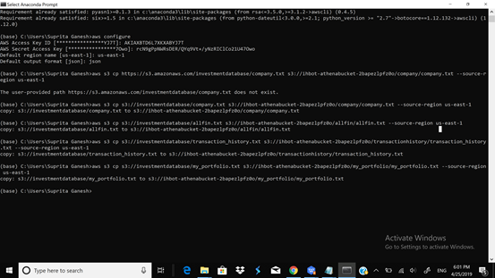
CONNECTION TO AWS SERVER
To connect data from S3 bucket and load it as data frame for Athena

Slide 14
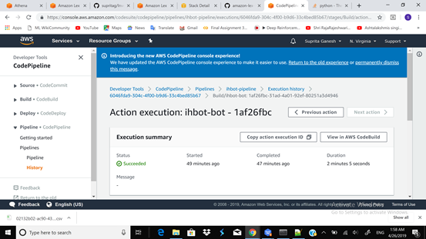
SUCCESFUL BUILT

Slide 15
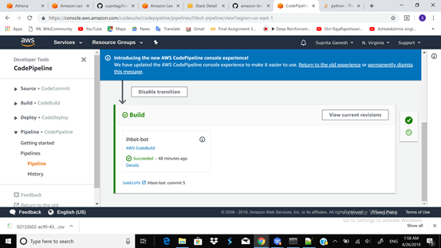
BUILT LEX BOT FROM GITHUB REPOSITORY

Slide 16
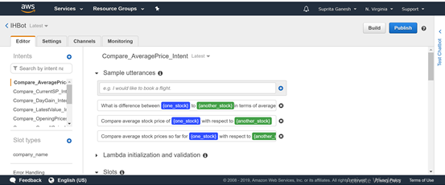
SUCCESSFUL BUILT OF AWS BOT

Slide 17
THANK YOU ☺

